Slide 1

Supervisor Name : Dr. Mayank Dave Presented By : Paras Garg(324103210)
Hybrid Deep Learning for Robust Deepfake Video
Detection with Enhanced Generalization and
Fairness
End Semester Presentation of Dissertation Part-I
MCO2D01

Slide 2
Contents
S.No | Topic | Slide No
1. | Introduction | 3
2. | Literature Review | 4
3. | Identified Gaps in Previous Research | 5
4. | Data Collection | 6
5. | Dataset Preprocessing | 7
6. | Proposed Improvements | 8
7. | Flow of the Architecture | 9
8. | Results | 10
9. | Conclusion | 11
10. | Current Status | 12
11. | Future Scope | 13
12. | References | 14

Slide 3
Introduction
The rapid growth of generative AI has made it simple to create highly realistic deepfakes, raising serious concerns about digital media trust.
Malicious applications include disinformation campaigns, financial fraud, and privacy violations, making robust detection methods essential.
This paper introduces a hybrid deep learning architecture designed to identify manipulated videos by detecting inconsistencies between frames.
The architecture combines Convolutional Neural Networks (CNNs) for spatial analysis, Recurrent Neural Networks (RNNs) for temporal analysis, and an attention mechanism to focus on key regions

Slide 4
Literature Review
Early detection methods used CNNs to find spatial artifacts in single frames but often missed inconsistencies between frames.
Later research incorporated RNNs to analyze temporal features like unnatural motion, improving detection of video manipulations.
Hybrid models that combine spatial and temporal analysis show greater promise, but many still perform poorly on new, "in-the-wild" deepfakes.
Significant challenges remain, including poor generalization, dataset bias causing fairness issues, and the constant evolution of forgery techniques.

Slide 5
Identified Gaps in Previous Research
Many existing deepfake detection methods perform poorly when faced with new forgery techniques or "in-the-wild" examples they were not trained on.
While detectors show high accuracy on academic benchmarks, their performance can drop by 50% or more on contemporary, real-world deepfakes.
Training data often contains biases, causing detection algorithms to perform unequally across different demographic groups, such as race or gender.
This creates a critical need for detection models that generalize well to unseen data and address fairness disparities.

Slide 6
Data Collection
Celeb-DF: Focuses on realistic deepfakes.
DeepFake Detection Challenge (DFDC): Large-scale, diverse deepfake dataset.
FaceForensics++ (FF): Contains various manipulation techniques.
Combining these datasets ensures the model learns from a wide range of deepfake generation methods and real video variations.
Training Videos : 4510 (Real: 2318 Fake: 2192)
Testing Videos : 1128 (Real: 591 Fake: 537)

Slide 7
Dataset Preprocessing
Frame Extraction: Videos are split into individual frames, and a face detection algorithm crops the facial regions.
Normalization: All cropped face frames are resized to a uniform 112x112 pixels and normalized using ImageNet's mean and standard deviation.
Sampling: A fixed frame sampling strategy of 10 frames per second is used for consistency across all videos.
Data Augmentation: To improve robustness, various augmentations are applied, including random horizontal flips, rotations, color adjustments, and the addition of noise or blurring.

Slide 8
Proposed Improvements
The proposed framework is a hybrid architecture designed to capture both spatial and temporal features effectively.
Spatial Feature Extraction: A pre-trained ResNet50 model is used to extract detailed spatial features from each individual video frame.
Temporal Anomaly Detection: A Bidirectional Gated Recurrent Unit (Bi-GRU) processes the sequence of spatial features to identify temporal inconsistencies and unnatural flow between frames.
Attention Mechanism: A Multi-Head Attention layer is applied after the Bi-GRU to allow the model to focus on the most significant parts of the video sequence that indicate manipulation.

Slide 9
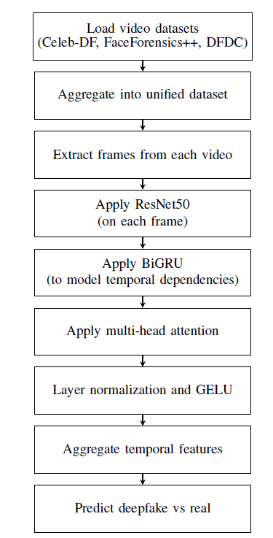
Flow of the Architecture

Slide 10
Results
The proposed hybrid model achieved strong performance on the aggregated test dataset:
Accuracy: 0.9266
AUC: 0.925
F1-Score: 0.9244
Comparative Analysis: The model demonstrated superior generalization capabilities when compared to several existing state-of-the-art models on diverse and challenging datasets.
Ablation Studies: Removing key components like the Bi-GRU or Multi-Head Attention layer resulted in a significant drop in performance, confirming the importance of each part of the hybrid architecture. For example, removing the attention mechanism lowered the AUC from 0.925 to 0.8455.

Slide 11
Conclusion
This research successfully developed a hybrid deep learning solution that combines CNNs for spatial analysis, Bi-GRUs for temporal analysis, and Multi-Head Attention for contextual focus.
By training on a large, aggregated dataset (FF++, Celeb-DF, DFDC) and using data augmentation, the model's ability to generalize to unseen data and avoid biases was significantly improved.
Experimental results show the proposed architecture outperforms many existing methods, especially on diverse, "in-the-wild" deepfakes.
The work represents a significant step toward creating reliable, robust, and fair deepfake detection systems for real-world applications.

Slide 12
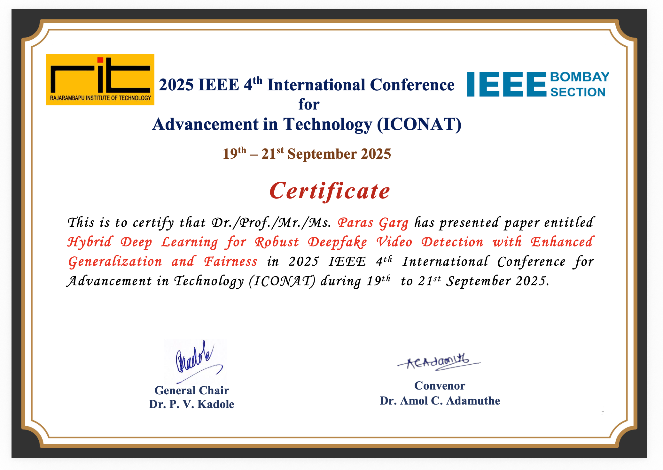
Current Status
Paper has been accepted and presented at 2025 IEEE 4th International Conference for Advancement in Technology (ICONAT).

Slide 13
Future Scope
Advanced Architectures: Explore the use of other models like Vision Transformers (ViTs) for feature extraction, as they are skilled at finding global relationships in images.
Multi-Modal Detection: Incorporate audio analysis into the model, as many deepfakes also feature manipulated audio streams, to create a more comprehensive detection system.
Robustness to Attacks: Research methods to enhance robustness against adversarial attacks, such as using adversarial training techniques.
Real-Time Deployment: Work on model optimization through techniques like pruning and quantization to reduce computational costs and enable real-time application and scalability.

Slide 14
References
R. B. P. and M. S. Nair, "Deepfake Detection using Multi-path CNN and Convolutional Attention Mechanism," 2022 IEEE 2nd Mysore Sub Section International Conference (MysuruCon), Mysuru, India, 2022, pp. 1-6, doi: 10.1109/MysuruCon55714.2022.9972657.
Das, S. Das and A. Dantcheva, "Demystifying Attention Mechanisms for Deepfake Detection," 2021 16th IEEE International Conference on Automatic Face and Gesture Recognition (FG 2021), Jodhpur, India, 2021, pp. 1-7, doi: 10.1109/FG52635.2021.9667026.
Wang, Shuai & Zhu, Donghui & Chen, Jian & Bi, Jiangbo & Wang, Wenyi. (2024). Deepfake face discrimination based on self-attention mechanism. Pattern Recognition Letters. 183. 10.1016/j.patrec.2024.02.019.
D. Afchar, V. Nozick, J. Yamagishi and I. Echizen, "MesoNet: a Compact Facial Video Forgery Detection Network," 2018 IEEE International Workshop on Information Forensics and Security (WIFS), Hong Kong, China, 2018, pp. 1-7, doi: 10.1109/WIFS.2018.8630761.

Slide 15
Thank You !!

